Slide 1
Our reading strategy is Questioning
Questioning Stems
Who
What
When
Where
I wonder
Why
How
What if
Why do you think
How do you think
How do we know
What is questioning?
Why do we ask questions?
Asking questions is seeking information.
When we ask questions, we think more deeply about the whole text and we check our understanding as we read.
What makes good questions?
Asking more open ended questions which encourage thinking about the text.
The questions in bold are more likely to be open questions but can also be closed e.g. Why was she feeling sad? Closed
Why do you think Harry acted in that way? Open
Notes:
On this slide would be stems and definition

Slide 2
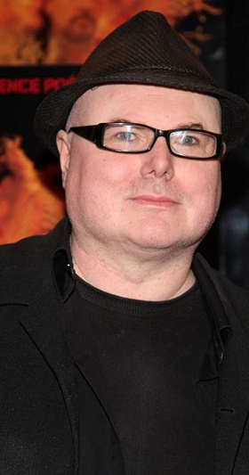
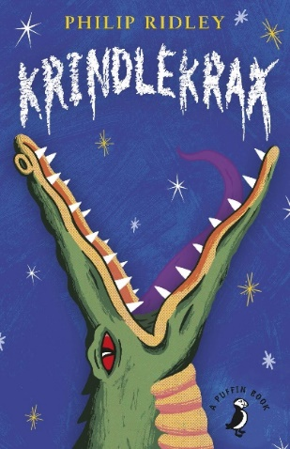
Context of the story
Context / Knowledge
Author: Philip Ridley
Talking partners: What has happened so far in the story?
Notes:
This slide would be about a recap / context to what you were teaching. This may only be applicable if a new text.

Slide 3
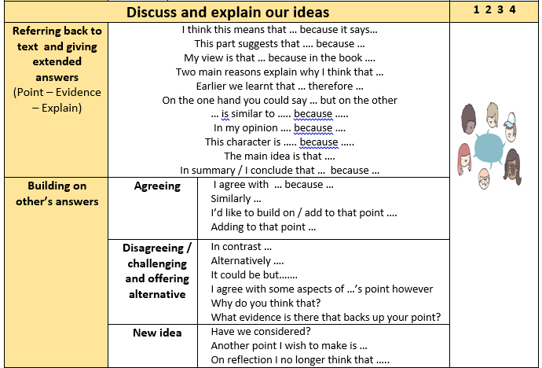
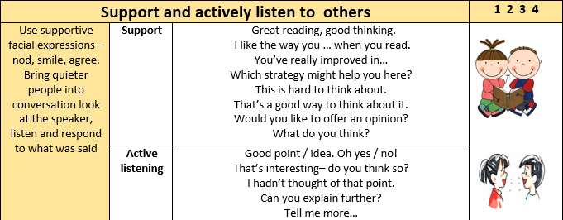
Our Learning Behaviours
Today we are focusing on…teacher selects one
Let’s focus on: Discuss and explain our ideas
Notes:
Be succinct

Slide 4
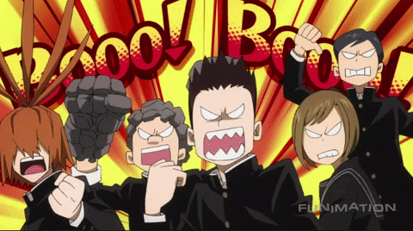
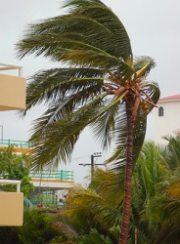
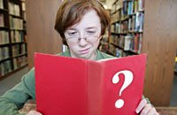
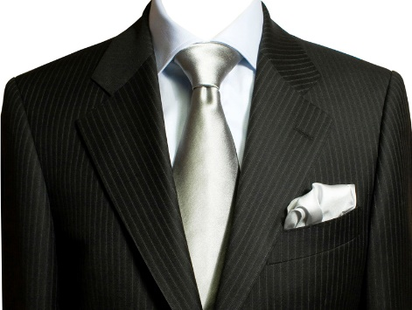
Vocabulary
Picture
Saying rude and mocking things, usually in a loud voice
jeering
Non-stopping, intense
relentless
Talk or write in a foolish way
twaddle
The part on each side of a coat of jacket that is folded back on either side
lapels
Notes:
This would be key / new vocabulary that will come up in reading , with picture and definition.

Slide 5
Chapter 20
Questioning Stems
Who
What
When
Where
I wonder
Why
How
What if
Why do you think
How do you think
How do we know
After school, Ruskin helped Corky sweep up the broken glass from the school playground.
“Before long,” Corky said, “Lizard Street won’t be called Lizard Street any more. It’ll be known as the Street of Broken Windows.”
“Ruskin told Corky how Elvis had threatened to break his glasses as well as all his windows.
“Are you scared, my boy?” Corky asked, sweeping the glass into a neat pile.
“A little bit,” Ruskin replied, brushing the glass into a bin bag.
Key Questions:
Where is this conversation between Corky and Ruskin taking place?
Why did Corky say that soon their street will no longer be called Lizard Street?
Challenge: Why do you think Ruskin is helping Corky sweep up the broken glass?
Notes:
Text broken down into Think aloud, talk partners, picture of book and stems

Slide 6
Partner work:
Questioning Stems
Who
What
When
Where
I wonder
Why
How
What if
Why do you think
How do you think
How do we know
In your partners, read the rest of chapter 20 (pages 88-92).
Remember at the end of each page, use the question stems to ask your partner a question.
Once you are complete, answer the selfie.
Notes:
Organisation page

Slide 7
Retrieval task
1. What did Corky say he would buy on the walk home with Ruskin?
_________________________________________
2. What in the movie made the ‘whooshing’ noises?
_________________________________________
3. True or false?
 | True | False
Mr Flick straightened his tie as he told Elvis to be quiet.
Elvis and Sparkey found it funning that the ball shot through the screen
Ruskin admits he is a bit scared of Elvis to Corky.
Corky doesn’t mind people talking during the film.

Slide 8
Mini tasks:
Vocabulary:
Find and copy a word from the text that has the same meaning as huge.
Explain:
Which words/phrases most effectively told you that Mr Flick was upset that his screen had been torn? Explain your answer.
Prediction:
What do you think is going to happen next in the story?

Slide 9
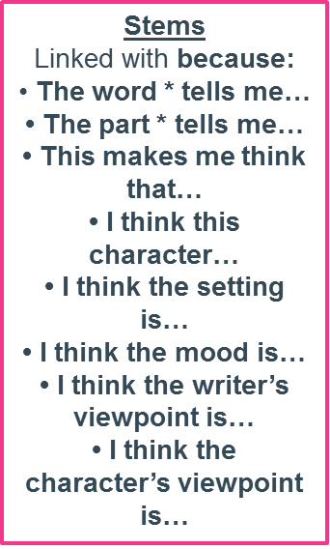
Different stems we use in our reading lessons:
Summarising Stems
The most important ideas are…and I know this because…
The key idea is…
This book/chapter/ paragraph is about…
The first/middle/last part was about…
The main theme is …
The headline would be…
In 10 words…
Questioning Stems
Who
What
When
Where
I wonder
Why
How
What if
Why do you think
How do you think
How do we know
Making connections Stems
Links text to self:
I know a lot about this because
I’ve been to / seen …
I saw a programme about this
I can identify with this character because ……
Links text to text:
I think this book is a (genre) book.
This reminds me of …
This is similar to
This character is similar to … because
Links text to world:
This links to …
This is because …
Evaluating stems
The word/phrase * works well because…
• I like the way the author uses*
It makes me think about *
• I think it would have read better if *
• It’s very clever the way the author uses (e.g. imagery) because *
• That sentence has high impact because *

